Slide 1


If You Can’t Beat Them, Augment Them
Improving Local WiFi with Only Above- driver Changes
Ahmed Saeed*, Mostafa Ammar*, Ellen Zegura*, Khaled Harras†
*Georgia Institute of Technology
†Carnegie Mellon University Qatar

Slide 2
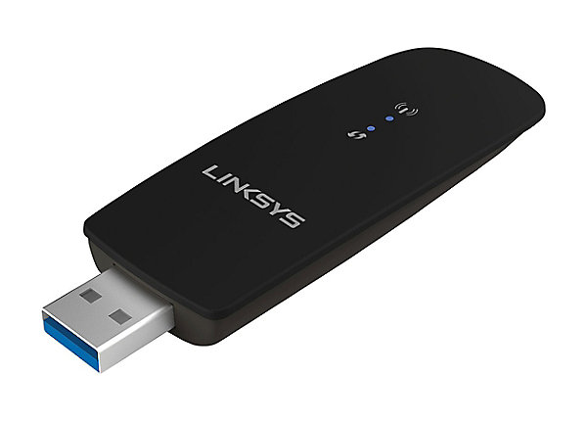



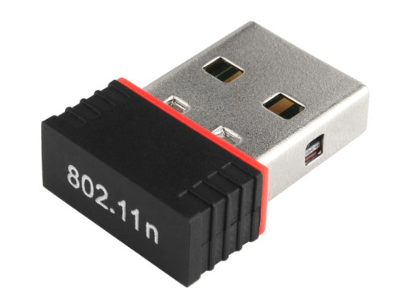









1999
2013
IEEE 802.11-ac
0.3-3 Gbps
IEEE 802.11-b
11 Mbps
2003
1997
IEEE 802.11-g
54 Mbps
IEEE 802.11- Legacy
2 Mbps
2009
IEEE 802.11-n
288/600 Mbps
1998
1993
2001
2005
1995
2016
2007
Augmented and Virtual Reality
Static Content
Video

Slide 3
1999
2013
IEEE 802.11-ac
0.3-3 Gbps
IEEE 802.11-b
11 Mbps
2003
1997
IEEE 802.11-g
54 Mbps
IEEE 802.11- Legacy
2 Mbps
2009
IEEE 802.11-n
288/600 Mbps
Evolving requirements
1998
1993
2001
2005
1995
2016
2007
Augmented and Virtual Reality
Static Content
Video

Slide 4
1999
2013
IEEE 802.11-ac
0.3-3 Gbps
IEEE 802.11-b
11 Mbps
2003
1997
IEEE 802.11-g
54 Mbps
Increasing bandwidth in > 10 Billion WiFi
IEEE 802.11- Legacy
2 Mbps
2009
IEEE 802.11-n
288/600 Mbps
Evolving requirements
1998
1993
2001
2005
1995
2016
2007
Augmented and Virtual Reality
Static Content
Video

Slide 5
1999
2013
IEEE 802.11-ac
0.3-3 Gbps
IEEE 802.11-b
11 Mbps
2003
1997
IEEE 802.11-g
54 Mbps
Increasing bandwidth in > 10 Billion WiFi
IEEE 802.11- Legacy
2 Mbps
2009
IEEE 802.11-n
288/600 Mbps
Same MAC protocol
Evolving requirements
1998
1993
2001
2005
1995
2016
2007
Augmented and Virtual Reality
Static Content
Video

Slide 6
WiFi Updates Dos
Upgradable with minimal overhead through above-driver OS patches
Backward compatible and interoperable with standard WiFi devices
Improve on WiFi’s performance for certain applications and should not degrade its performance for traditional use cases
Transparent to non-augmented devices and should not harm their performance

Slide 7
WiFi Updates Don’ts
Assume edits in firmware can be easily adapted by all manufacturers
Require strict time synchronization with both processing and networking overhead
Operate in promiscuous mode to listen to or detect certain types of packets which leads to
Power overhead to keep the network card on and listening
Processing overhead to process all overheard packets

Slide 8
Can we develop an effective WiFi augmentation with only above-driver patches?

Slide 9
Can we develop an effective WiFi augmentation with only above-driver patches?
Answer: soft scheduling at a coarse grain timescale

Slide 10
Related Work
Look Who’s Talking: Protocols that rely on overhearing other nodes’ transmission to coordinate schedules [Shih et al. CoNEXT ‘15]
TDMA: Leveraging time synchronization to coordinate schedules [Djukic et al. INFOCOM ‘09]
Overlay MAC protocols: Introduces layer 2.5 above MAC to coordinate MAC protocols [Rao et al. MobiSys ‘05]
Low Latency WiFi: Modified protocols to improve WiFi latency [Li et al. INFOCOM ‘15]

Slide 11
Outline
Augmenting WiFi with Soft Scheduling
Soft Token Passing Protocol (STPP)
STPP for Low Latency Local Communication
Evaluation
Summary and Conclusions

Slide 12
Augmenting WiFi with Soft Scheduling
Augmentation protocol
Computes a a schedule based on objective (e.g., node priority)
Attempts soft enforcement of schedule
WiFi
Enforces medium access control to handle failures of soft scheduler
Time scale
Augmentation Protocol
Millisecond
WiFi
Microseconds

Slide 13
Soft Schedule Enforcement
Time Division Multiple Access (TDMA) is a simple scheduling approach
Typical schedule maintenance require time synchronization
We rely on token passing
Caveat: Tokens can be lost

Slide 14
Token Recovery
Token Loss: Each link estimates the amount of time till it receives the token and timeouts after that period and assumes it has the token.
Multiple Token: All nodes keep track of the schedule and ignore tokens for a Token Expiry Period after sending their own token.
Node Failure: If a node is silent for more than two seconds, it is taken off the schedule.

Slide 15
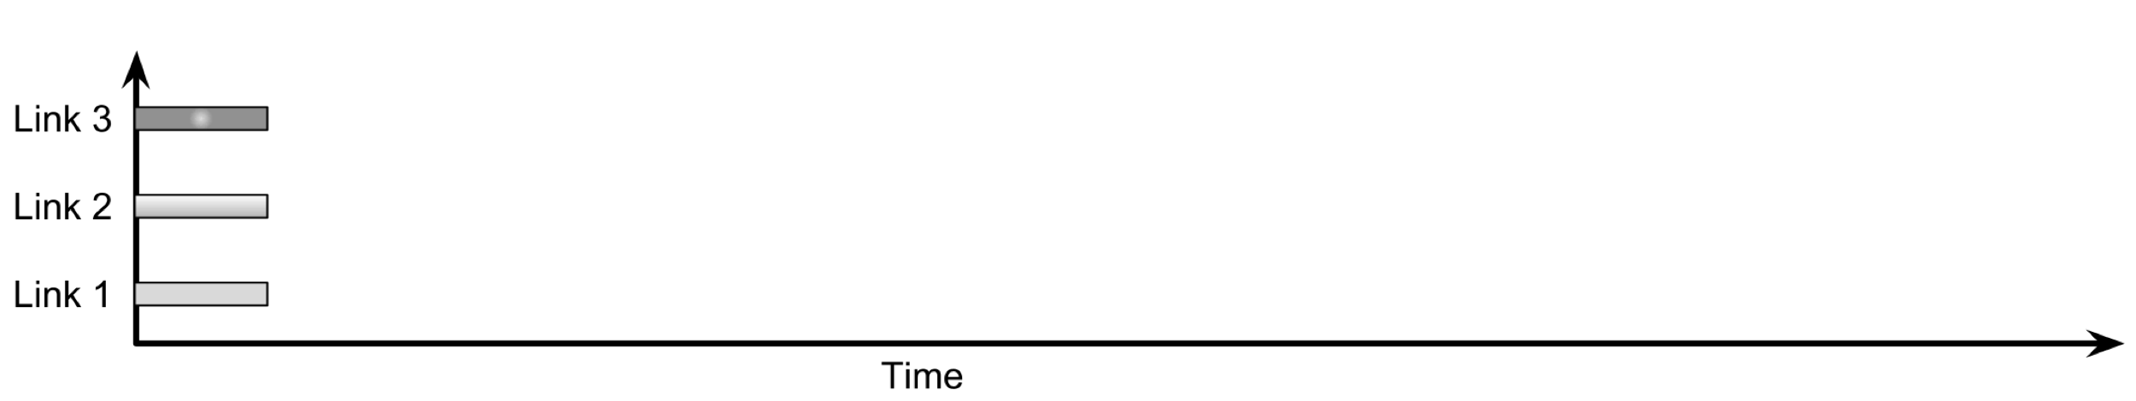
STPP Example

Slide 16
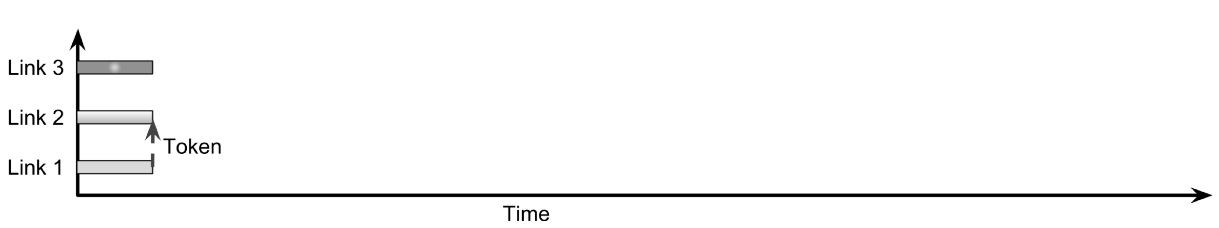
STPP Example

Slide 17
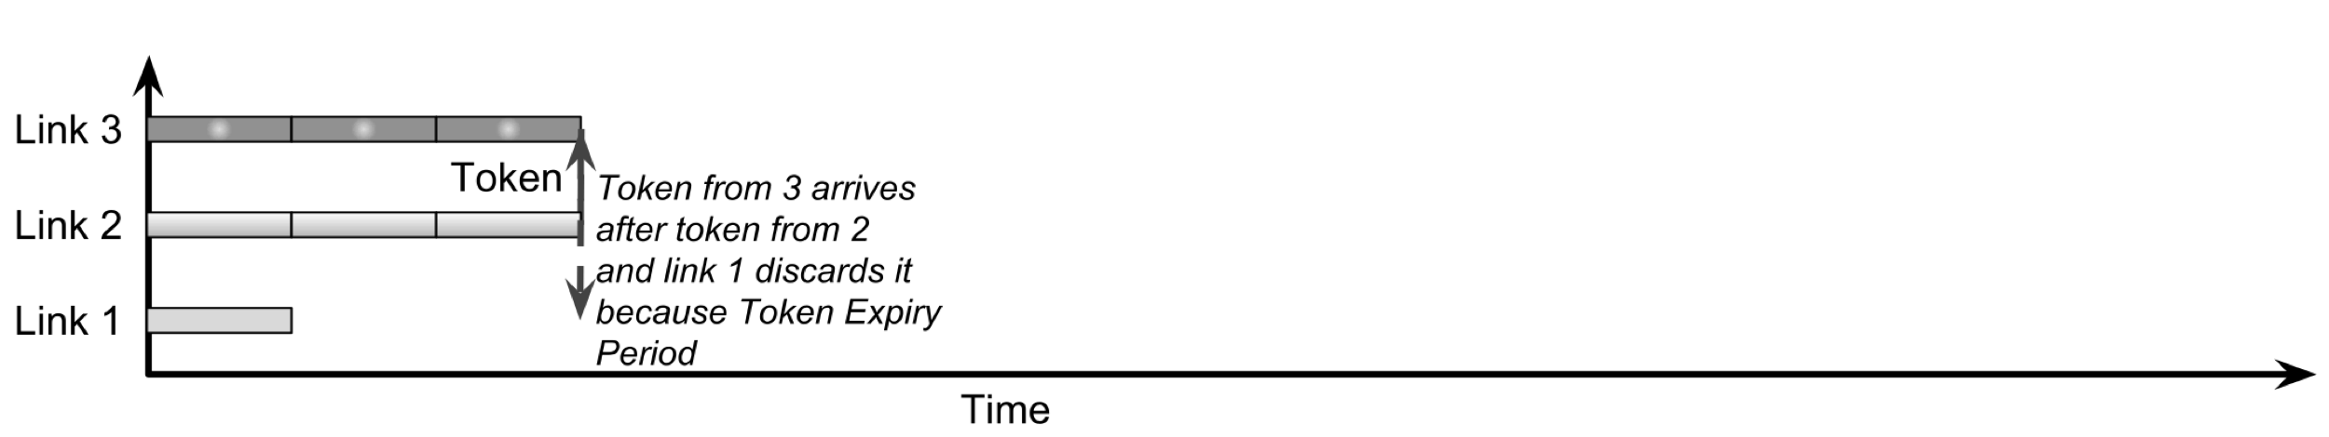
STPP Example

Slide 18
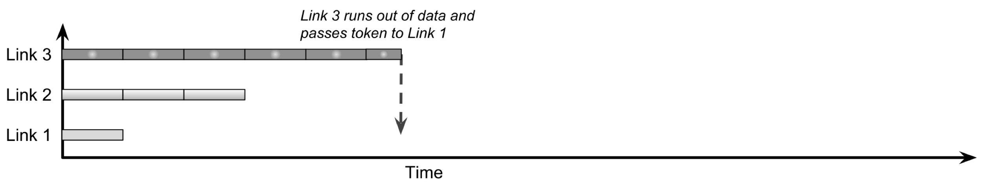
STPP Example

Slide 19
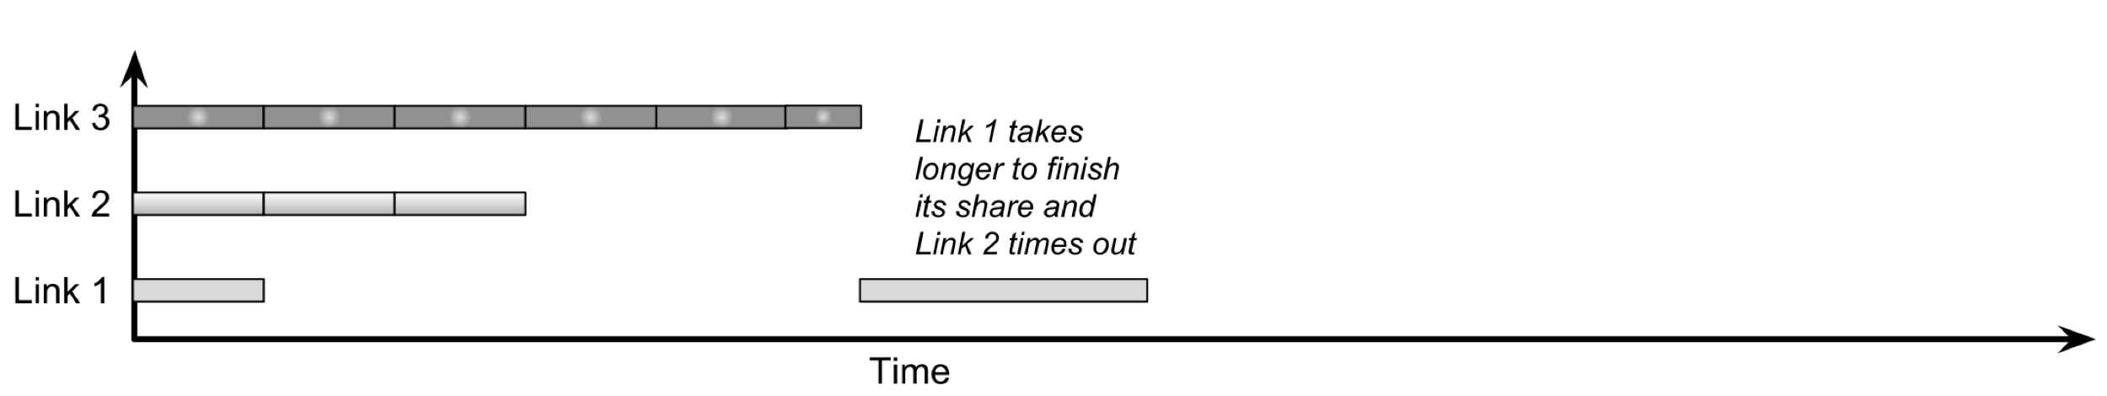
STPP Example

Slide 20
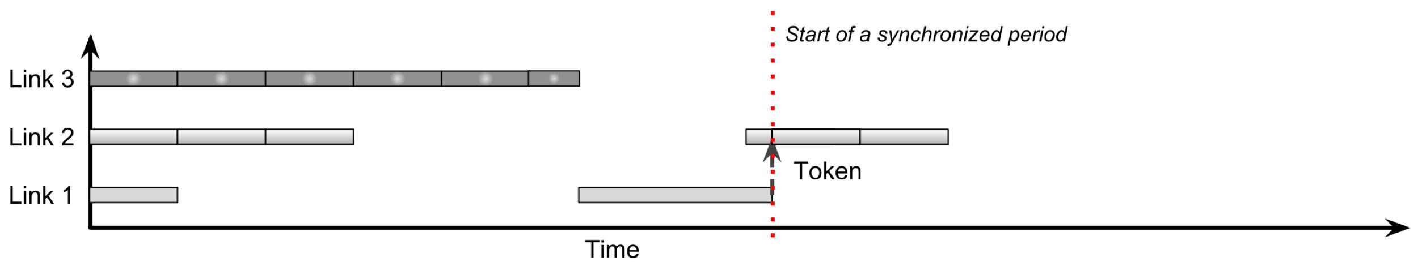
STPP Example

Slide 21
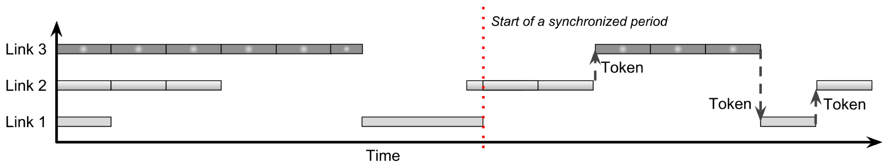
STPP Example

Slide 22
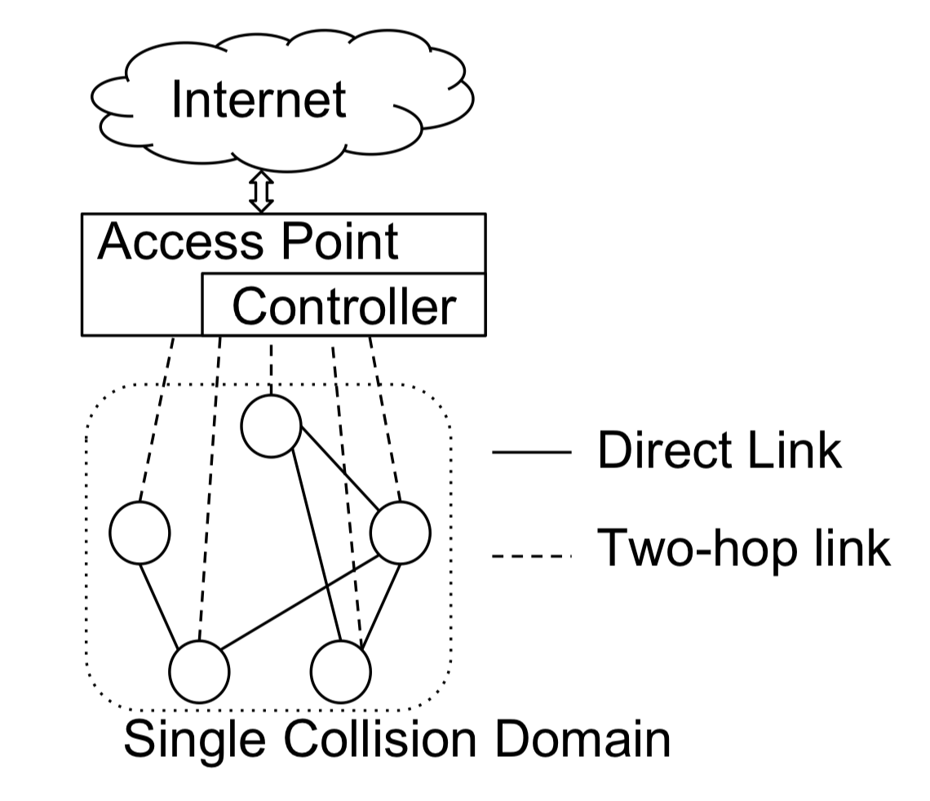
STPP Use Case: Wireless Low Latency Links (WL4)
AR and VR applications require low latency for a few links in a crowded network
Low latency required between devices in the same room and same collision domain
Controller collects demand/priorities and calculates schedule
STPP enforces priorities for medium access

Slide 23
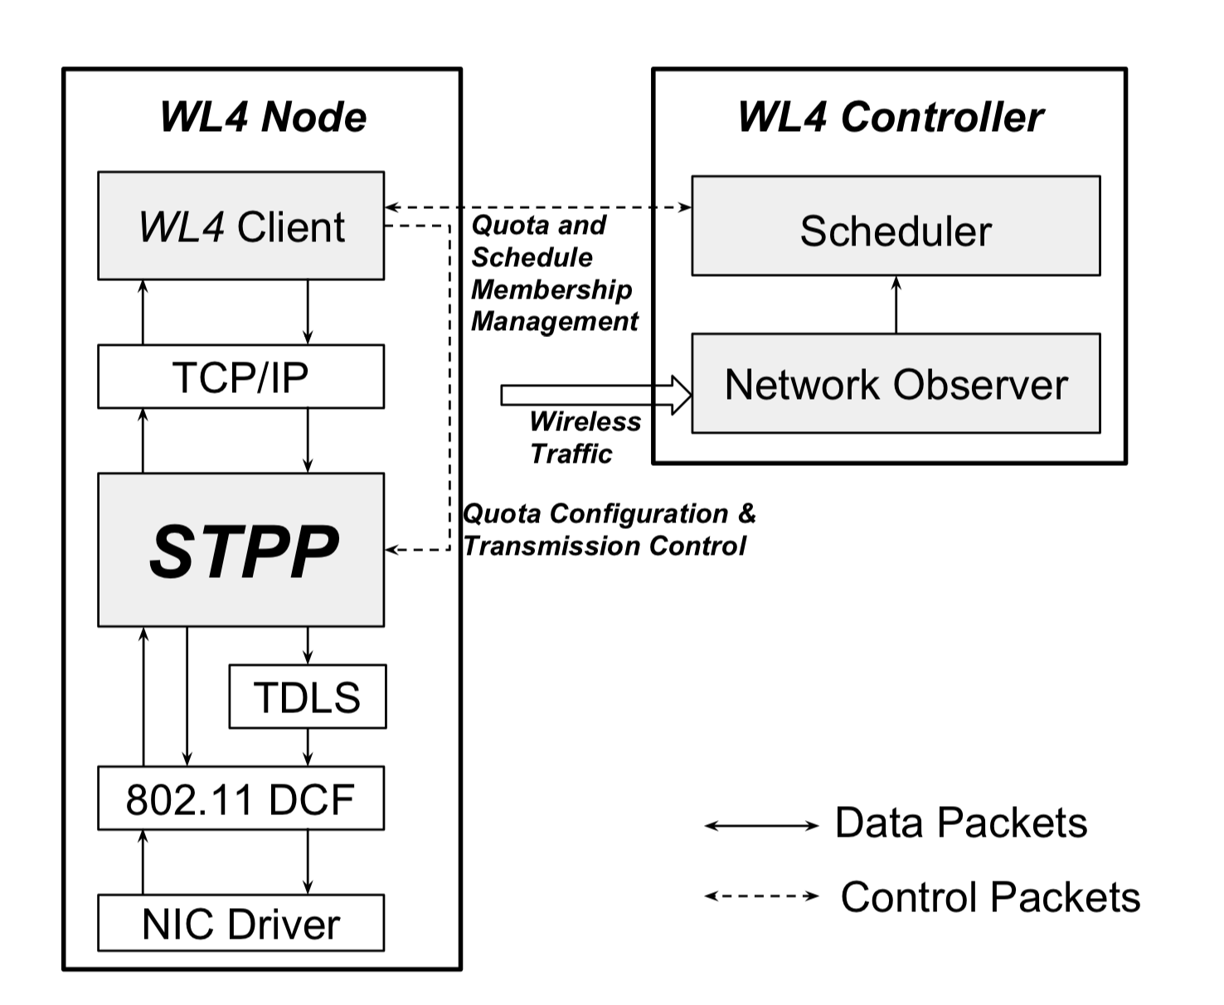

Implementation
Implemented in linux kernel 4.10 in mac80211 module
Our implementation operates only on direct links constructed using Tunneled Direct Link Setup (TDLS)
Tokens are processed by a user-space client implemented as a Click module
Code and tutorial https://www.cc.gatech.edu/~amsmti3/stpp/

Slide 24
Evaluation Setup
Five nodes each with the modified kernel
Direct links are constructed to allow all five nodes to communicate directly using TDLS
Standard Direct links implementation is our baseline
netperf is used to generate TCP traffic
Estimated RTT measurements are collected from TCP sources every 100ms
q_{max} determines the priority of the link

Slide 25
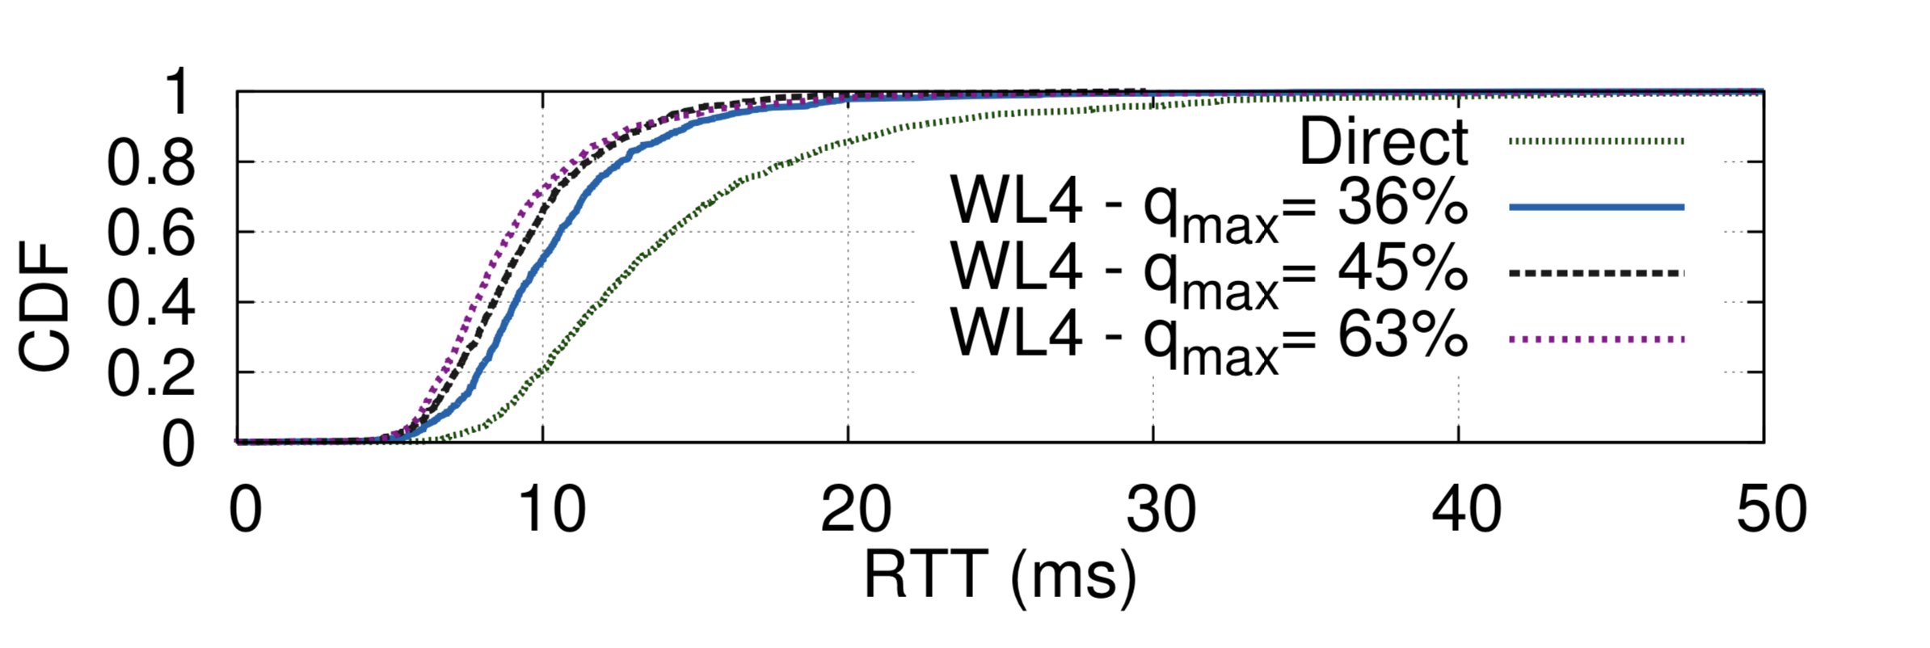
Impact on High Priority Link
Higher priority can improve RTT by up to 40%

Slide 26
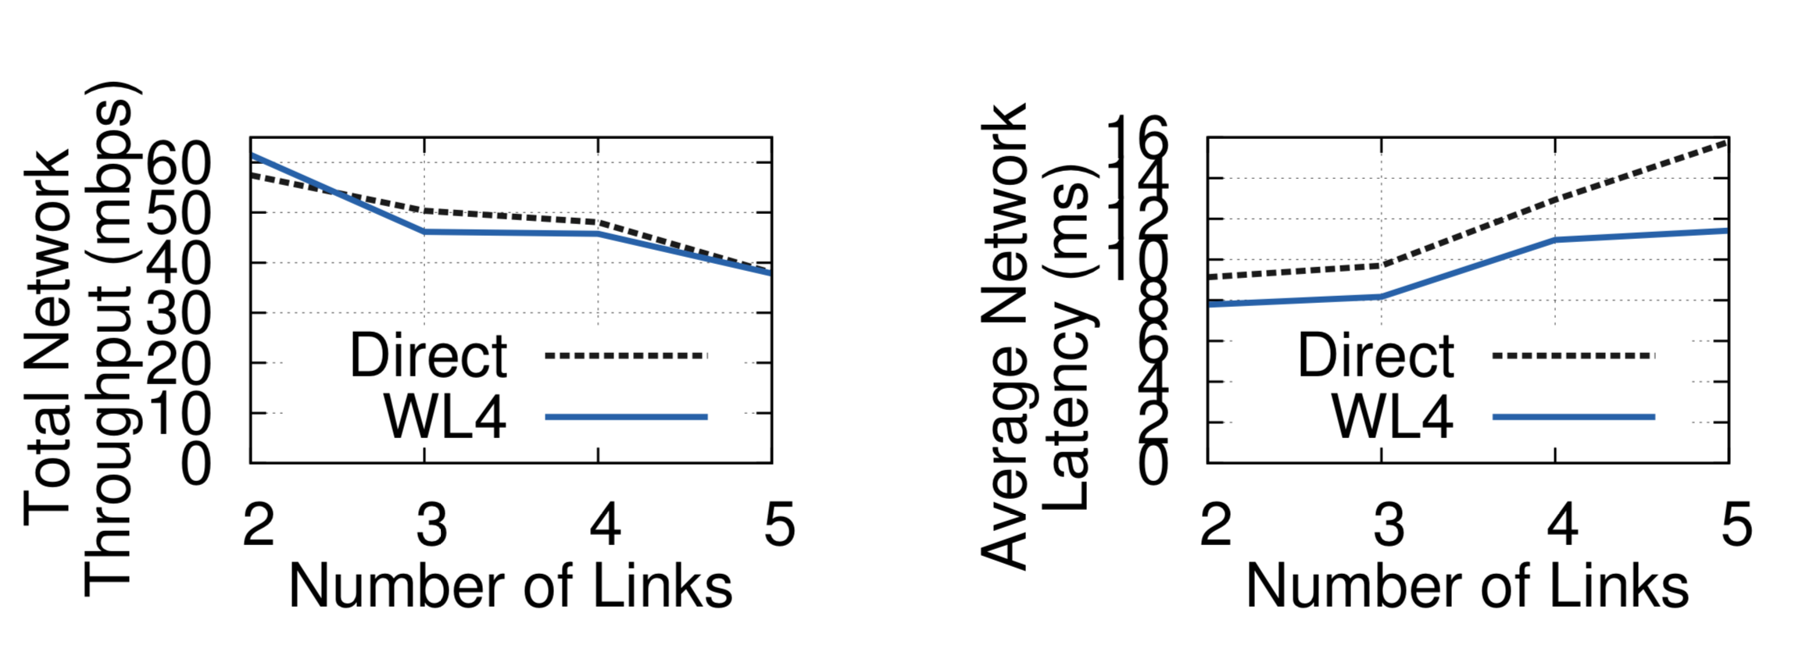
Impact on Average Network Behavior
WL4 improves average RTT by up to 38% with minimal impact on throughput

Slide 27
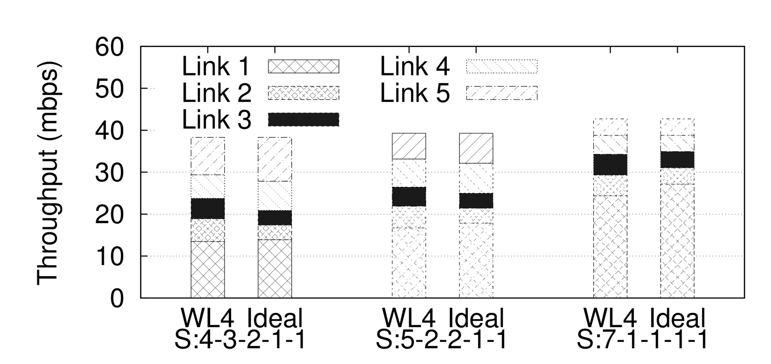
Share Division
WL4 can accurately prioritize medium capacity between competing links

Slide 28
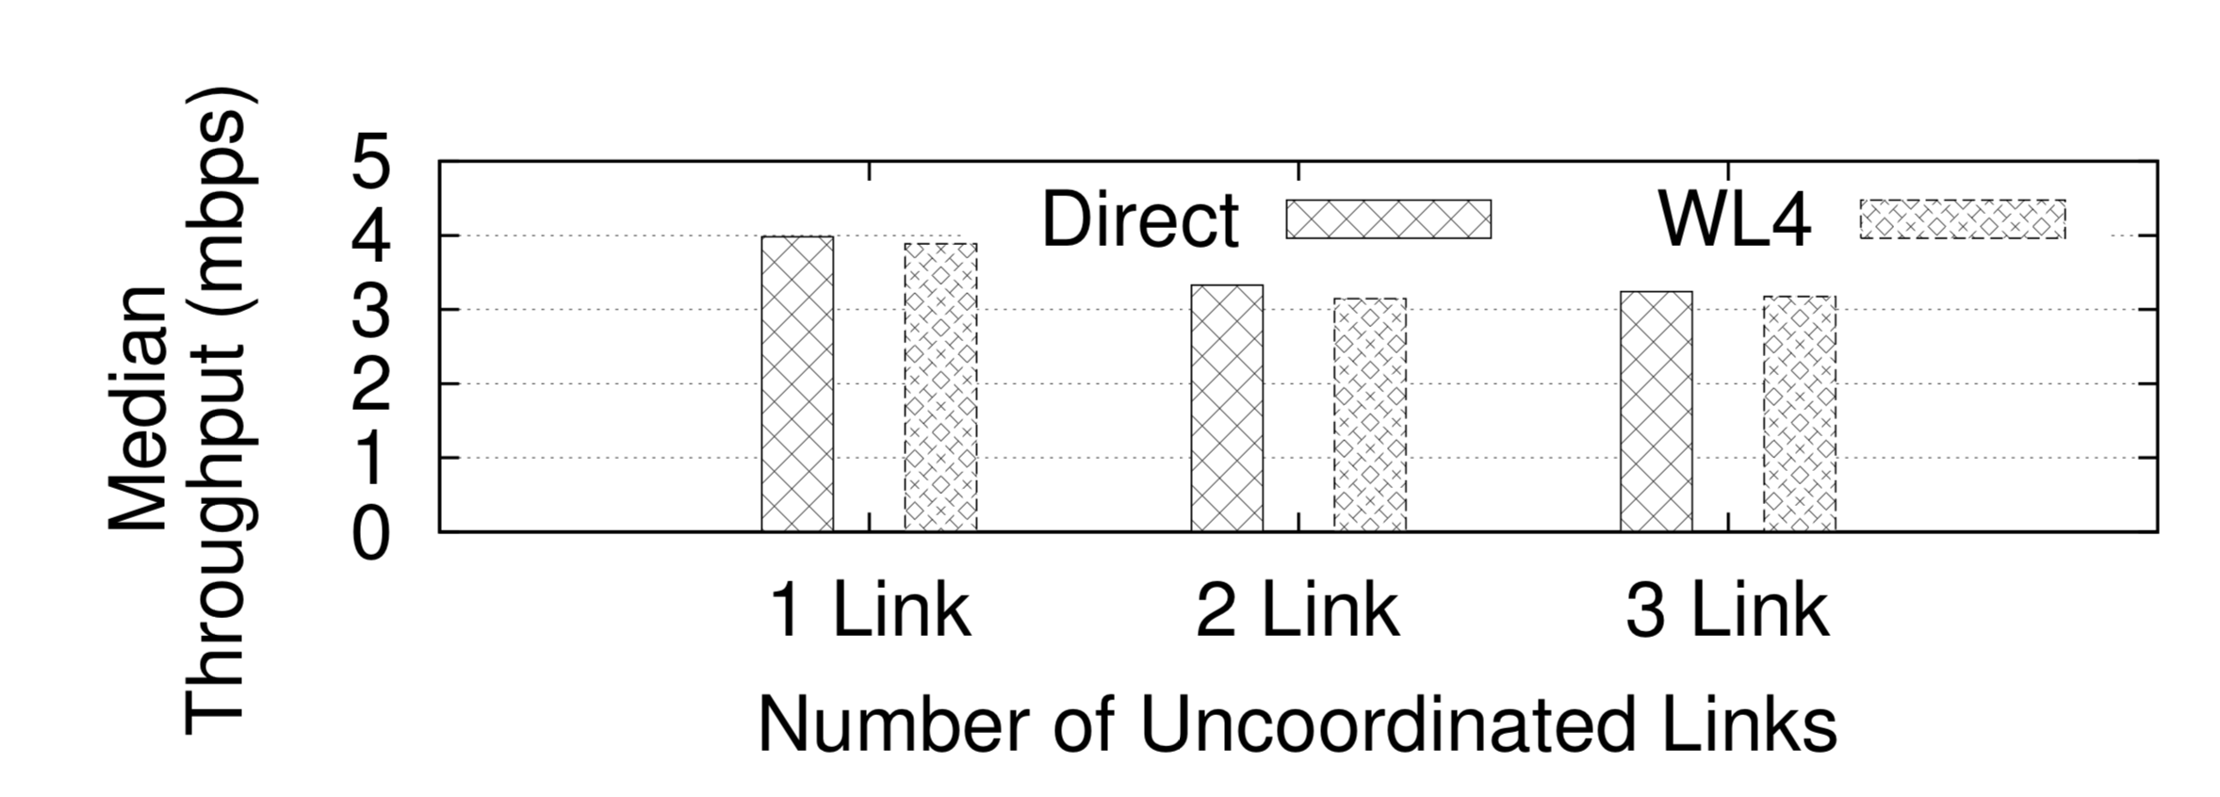
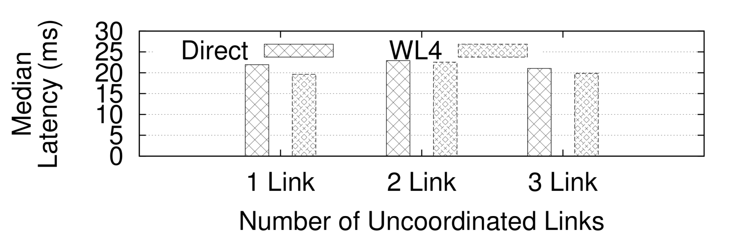
Effect of Unscheduled Traffic
Uncoordinated links do not impact the performance of WL4 links and vice versa

Slide 29
Summary and Conclusion
Application demands have been growing while WiFi MAC has been mostly unchanged for almost 20 years
WiFi improvements with minimal system modifications are feasible leveraging soft scheduling
STPP can introduce up to 40% latency reduction without sacrificing throughput

